Slide 1
531.82 GWh
Net Electrical Energy
496.5 GWh
1472 GWh
1744.06 GWh
Incident Solar Energy
3513.2 GWh
1813.8 GWh
Parasitic Losses
36.2 GWh
Reflectivity + Other Losses
20.47 GWh
Power Block Losses
940.2 GWh
Radiation Losses
170.5 GWh
Convection Losses
81.1 GWh
Dumped Energy
69.8 GWh
Solar Field Losses
1699.4 GWh

Slide 2
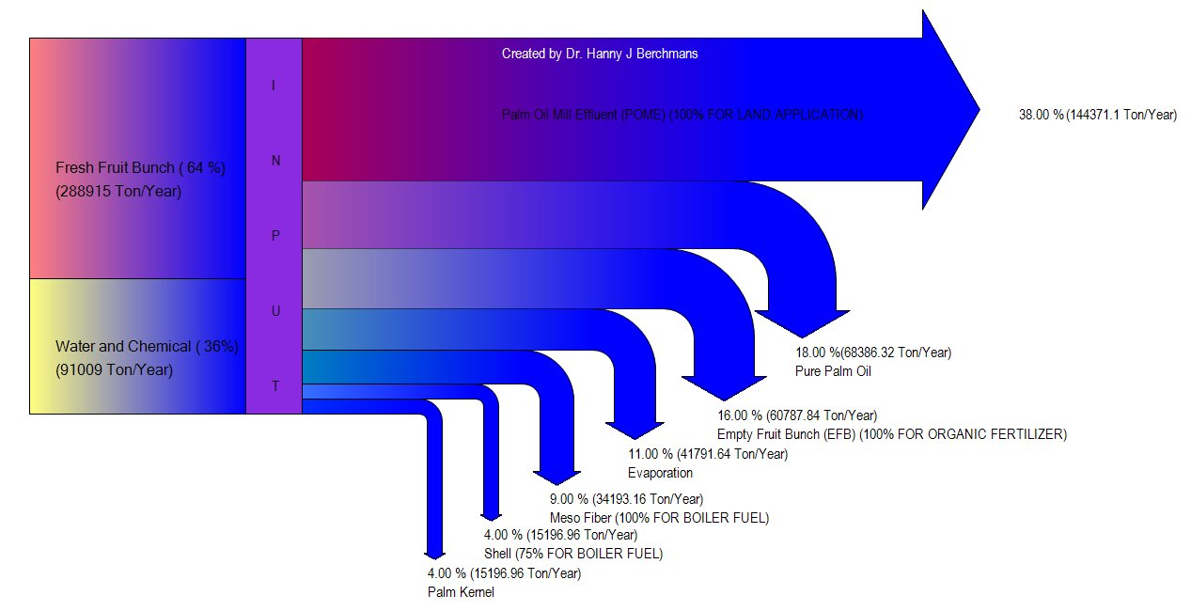

Slide 3
